Slide 1
Innovative Pathways to Creating Certainty in Uncertain Times
John Smith
Regional Program Director

Slide 2


A Time of
Uncertainty
The unemployment rate in
San Leandro is 10.70 percent
(U.S. avg. is 9.10%).
Alameda Country assessed
Property values dip.
San Leandro Redevelopment
Agency Must Pay $7.6 Million
to State
Cherry Festival 2010 & 2011 has been
Cancelled due to budget reductions.

Slide 3
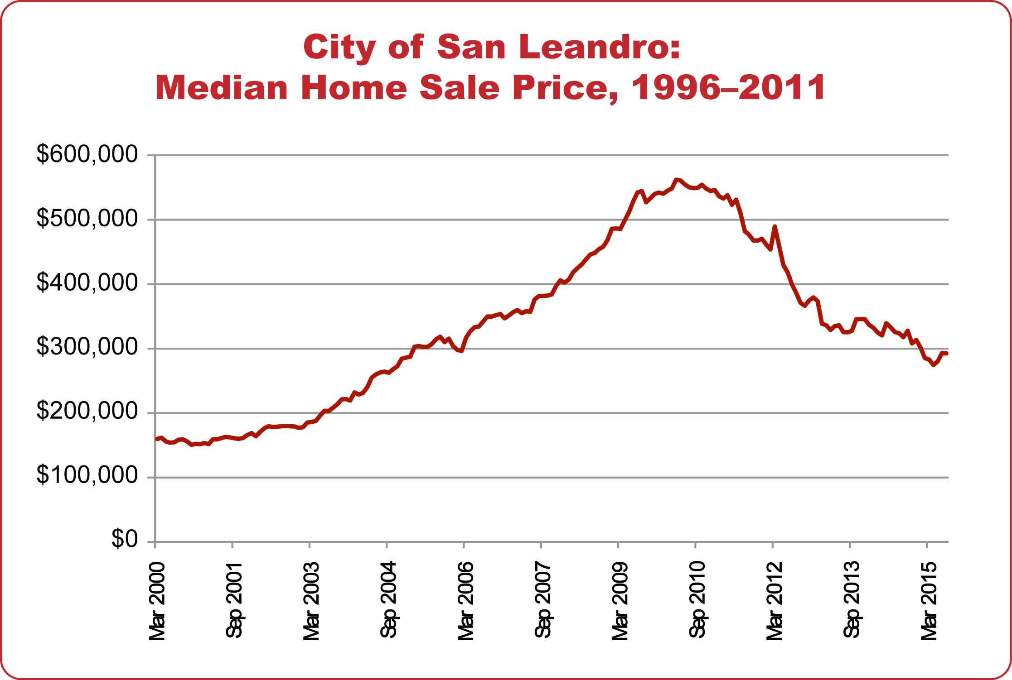
Impact of Uncertainty
Diminishing Sense of Place
Increasing Crime
Falling Tax Revenues
Source: Zillow.com, through 7/31/11

Slide 4
Possible Pathways During Uncertain Times
1
Holding Pattern
2
Reactive Measures
Creating
Innovative
Solutions
3
Notes:
Holding Pattern – Uncertainty leads to inaction – I think RDA dollars is a couple example do we refund? Do we wait to see what happens in the courts? What’s happening in san Leandro on this.
Reactive Measures – Making ends meet. Do what it takes to makes end meet – e.g. Santa Rosa is turning off street lights. Challenge of course is you cut what thing and unintended or unavoidable consequence does that have.
We believe there are options and strategies in times of adversity so we work with cities to create innovation solutions.

Slide 5




Certainty Strategy
Reduce Costs & Increase Revenue
San Leandro’s
Strategy
Community Engagement
Collaborate with Schools
Safe & Vibrant Downtown
Local Economic Development

Slide 6


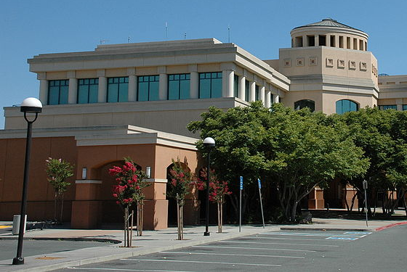

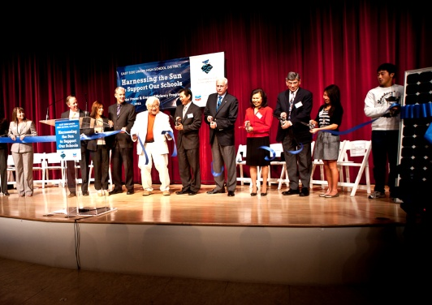
Local Success Stories
Our Mission: Benefit the Communities
Where We Live and Work
South San Francisco USD
Santa Rita Jail
Bellevue, USC
San Jose USD
Morgan Hill USD
Contra Costa CCD
Milpitas USD
Chabot-Las Positas CCD
City of Benicia
City of Concord
East Side UHSD

Slide 7

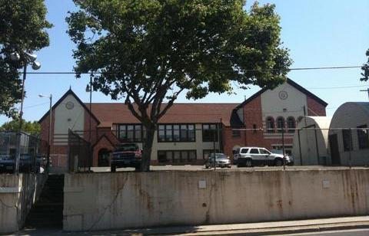
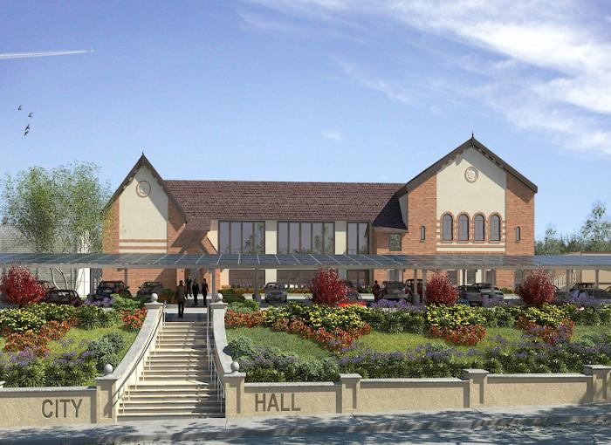
City of Benicia Under Construction
Population: 28,000
Advances City’s Climate Action Plan – reduces GHG emissions equivalent to carbon sequestered annually by 405 acres of pine forests
  Improves safety with city lighting program
Requires no capital contribution and delivers +85K in annual savings
Improves the aesthetics, sense of place and accessibility of the City Hall
Company Confidential

Slide 8

Chevron
Energy Solutions
Invest in people to strengthen organizational capability and develop a talented global workforce that gets results the right way
Compelling market opportunity has spurred new market entrants
CES is evolving to maintain a competitive advantage
CES is transforming our go-to-market strategy from a solutions provider to a thought leader

Slide 9
Pathways to Innovation
Exploration
Validate vision
Development
Quantify funding opportunities and
economic development
Implementation
Realize benefit, Create jobs
Share success with the community

Slide 10

For more information,
please contact:
John Smith
10

